Slide 1


in-flight to insights:
Real-time insights with Event Hubs, Stream Analytics and an A10 Warthog
Adam Finster
Architect
BCM Solutions
Todd Whitehead
Cloud Solution Architect
Microsoft

Slide 2
Disclaimer
Whilst I am employee of Microsoft, the views, opinions and lame jokes that I may or may not present tonight are my own and in no way represent those of Microsoft or in fact any person living or dead beginning with the letter M.

Slide 3
Agenda
Data in Motion (aka into the dangerzone)
Demo (aka I feel the need!)
Concepts (aka What the hell did I just see)
Peeling apart the demo (aka Goooooose!)
Real-time in the real-world (aka But I don’t have an A10!)
Resources and Tools

Slide 4


What is Streaming Data?
Data at Rest
Data in Motion

Slide 5















Azure Streaming/IoT services
Devices | Device Connectivity | Storage | Analytics | Presentation & Action
 | Event Hubs | SQL Database | Machine Learning | App Service
 | Service Bus | Table/Blob Storage | Stream Analytics | Power BI
 | External Data Sources | DocumentDB | HDInsight | Notification Hubs
 |  | External Data Sources | Data Factory | Mobile Services
 |  |  |  | BizTalk Services
{ }

Slide 6




Demo Architecture
Event Producers
Ingestion
Transformation
Long Term Storage
Presentation & Action
Data collector of doom
Event Hub
Stream Analytics
SQL
Power BI
Blob

Slide 7

Demo

Slide 8
Demo Architecture
Event Producers
Ingestion
Transformation
Long Term Storage
Presentation & Action
Data collector of doom
Event Hub
Stream Analytics
SQL
Power BI
Blob

Slide 9

Canonical Eventing scenario
Event producers
Collection
Ingestor (broker)
Transformation
Long-term storage
Presentation and action
Stream Analytics
Web/thick client dashboards
Applications
Service bus
Event hubs
Azure DBs
Legacy IOT (custom protocols)
Stream processing
Search and query
Cloud gateways (web APIs)
Azure storage
Devices
Storage adapters
HDInsight
Data analytics (Excel)
IP-capable devices (Windows/Linux)
PowerBI
Low-power devices (RTOS)
Field gateways
Devices to take action

Slide 10
Event Hubs and Stream Analytics
Event Hub
Cloud-scale telemetry ingestion from websites, apps, and devices
Compatible with more than a million publishers supporting HTTP, AMQP and MQTT
Ingress millions of events per second
Configurable data retention (1-30 days)
Low latency (<10 ms for volatile data)
Pluggable with other cloud services like Stream Analytics
Stream Analytics
From events or data streams to insights in less time and effort
Real-time analytics for Internet of Things solutions
Stream millions of events per second
Mission critical reliability, performance and predictable results
Rapid development with familiar SQL-based language

Slide 11
Events and Time
Every event that flows through the system has a timestamp
User can pick it from the payload
SELECT * FROM TwitterStream TIMESTAMP BY CreatedAt
Or the system can assign timestamps automatically based on the event arrival time
SELECT * FROM TwitterStream
Projecting timestamp into payload
SELECT System.Timestamp AS Time, Text FROM TwitterStream
Note: System.Timestamp is a reserved property that exposes the timestamp of an event.

Slide 12
Tumbling Windows
Tell me the count of tweets per time zone every 10 seconds
A 10-second Tumbling Window
1
5
4
6
2
8
6
5
3
6
1
0
5
10
15
20
25
30
Time
(secs)
1
5
4
6
2
8
6
5
3
6
1
SELECT TimeZone, COUNT(*) AS Count
FROM TwitterStream TIMESTAMP BY CreatedAt
GROUP BY TimeZone, TumblingWindow(second,10)

Slide 13
Hopping Windows
A 10-second Hopping Window with a 5-second “Hop”
Every 5 seconds give me the count of tweets and the average sentiment score over the last 10 seconds
1
5
4
6
2
8
7
5
3
6
1
0
5
10
15
20
25
30
Time
(secs)
1
5
4
6
2
4
6
2
8
6
8
6
5
3
5
3
6
1
SELECT Topic, COUNT(*) AS TotalTweets, AVG(SentimentScore)
FROM TwitterStream TIMESTAMP BY CreatedAt
GROUP BY Topic, HoppingWindow(second, 10 , 5)

Slide 14
Sliding Windows
A 10-second Sliding Window
1
5
9
8
Give me the count of tweets for all topics which are tweeted more than 10 times in the last 10 seconds
0
5
10
15
20
25
Time
(secs)
1
1
5
1
5
9
8
SELECT Topic, COUNT(*) FROM TwitterStream
TIMESTAMP BY CreatedAt
GROUP BY Topic, SlidingWindow(second, 10)
HAVING COUNT(*) > 10

Slide 15
Joining multiple streams
List all users and the topics on which they switched their sentiment within a minute
Twitter Stream:
{“XO”, 4, “Ebola”}
{“Dip”, 2, “XBox”}
{“Jo”, 0, “ALS”}
{“Foo”,4, “ALS”}
Twitter Stream:
{“XO”, 0, “Ebola”}
{“Jo”, 4, “ALS”}
{“Dip”, 0, “Xbox”}
{“Foo”, 0, “ALS”}
time
SELECT TS1.UserName, TS1.Topic
FROM TwitterStream TS1 TIMESTAMP BY CreatedAt
JOIN TwitterStream TS2 TIMESTAMP BY CreatedAt
ON TS1.UserName = TS2.UserName AND TS1.Topic = TS2.Topic AND DATEDIFF(second, TS1, TS2) BETWEEN 1 AND 60
WHERE TS1.SentimentScore != TS2.SentimentScore

Slide 16
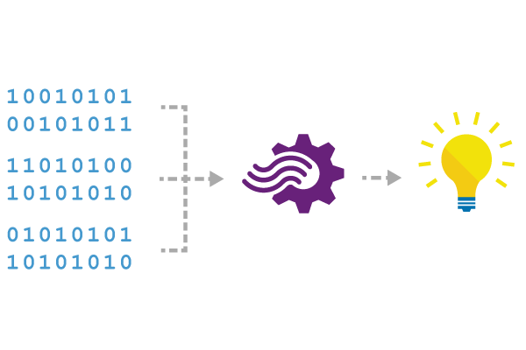
Reference Data
Seamless correlation of event streams with reference data
Static or slowly-changing data
Same programming experience:
SELECT myRefData.Name, myStream.Value
FROM myStream JOIN myRefData
ON myStream.myKey = myRefData.myKey

Slide 17
Walkthrough
Data collector of doom
Event Hub
Stream Analytics
Power BI

Slide 18
SAQL – Language & Library
DML
SELECT
FROM
WHERE
GROUP BY
HAVING
CASE WHEN THEN ELSE
INNER/LEFT OUTER JOIN
UNION
CROSS/OUTER APPLY
CAST
INTO
ORDER BY ASC, DSC
Date and Time Functions
DateName
DatePart
Day
Month
Year
DateTimeFromParts
DateDiff
DateAdd
Aggregate Functions
Sum
Count
Avg
Min
Max
StDev
StDevP
Var
VarP
Temporal Functions
Lag, IsFirst
CollectTop
String Functions
Len
Concat
CharIndex
Substring
PatIndex
Scaling Extensions
WITH
PARTITION BY
OVER
Windowing Extensions
TumblingWindow
HoppingWindow
SlidingWindow

Slide 19
Pricing
Stream Analytics is priced on two variables:
Volume of data processed
Streaming units required to process the data stream
Meter | Price (USD)
Volume of Data Processed Volume of data processed by the streaming job (in GB) | $.001 per GB
Streaming Unit Blended measure of cores, memory, and bandwidth | $0.031 per hour
* Streaming unit is a unit of compute capacity with a maximum throughput of 1MB/s

Slide 20
Example Pricing
Daily Azure Stream Analytics cost for 1 MB/sec of average processing
Volume of Data Processed Cost -
$0.001 /GB * 84.375 GB = $0.08 per day, streaming max 1 MB/s non-stop
Streaming Unit Cost -
$.031 /hr * 24 hrs = $0.74 per day, for 1 MB/sec max. throughput
Total cost -
$0.74 + $0.08 = $0.82 per day -or- ~ $25 per month

Slide 21




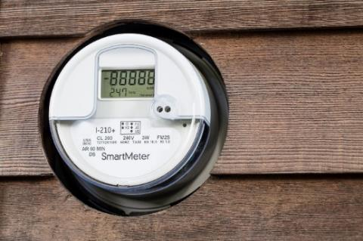
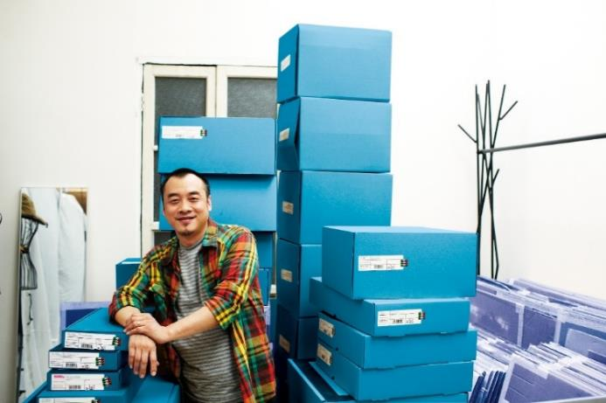


What are customers wanting to do?
Real-time fraud detection
Connected car scenario
Click-stream analysis
Real-time financial portfolio alerts
Smart grid
CRM alerting sales with customer scenario
Data and identity protection services
Real-time financial sales tracking

Slide 22
Azure IoT Reference Architecture
Devices and Data Sources
Data Transport
Device and Event Processing
Presentation
Cloud Gate-way
Data Visualization & Presentation
IP capable devices
Provisioning API
Solution Portal
Device State Store
Agent Libs
Identity & Registry Stores
Existing IoT devices
Stream Event Processor
Agent Libs
Gateway
Storage
Analytics/ Machine Learning
Low power devices
Agent Libs
Control System Worker Role

Slide 23

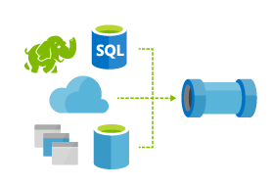



IoT Device & Cloud Patterns
Batch Analytics & Visualizations
Azure HDInsight, AzureML, Power BI,
Azure Data Factory
Cloud Gateway
Event Hub
Hot Path Analytics
Azure Stream Analytics, Azure Storm
Presentation & Business Connections
Websites, Mobile Services
Dynamics, BizTalk Services, Notification Hubs
Protocol Adaptation
Hot Path Business Logic
Service Fabric & Actor Framework
Devices
RTOS, Linux, Android, iOS, Windows
Field Gateway
Device
Connectivity & Management
Analytics &
Operationalized Insights
Presentation &
Business Connectivity

Slide 24

Useful Resources
Business Overview http://azure.microsoft.com/en-us/services/stream-analytics/
Documentation http://azure.microsoft.com/en-us/documentation/services/stream-analytics/
ASA Blog http://blogs.msdn.com/b/streamanalytics/rss.aspx
Follow us on Twitter https://twitter.com/AzureStreaming (follow @AzureStreaming)
ASA Forum https://social.msdn.microsoft.com/Forums/en-US/home?forum=AzureStreamAnalytics
Vote for ideas http://feedback.azure.com/forums/270577-azure-stream-analytics
Email ASA Team azstream@microsoft.com

